Slide 1
Whack A Mole
Group 3
2026
ENGG 3000

Slide 2
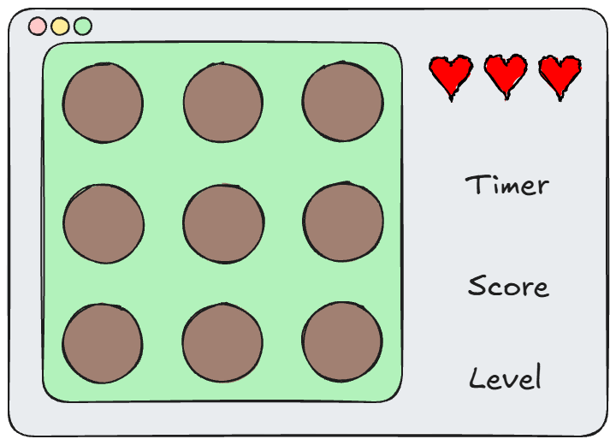
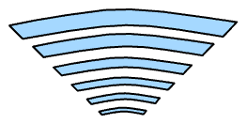
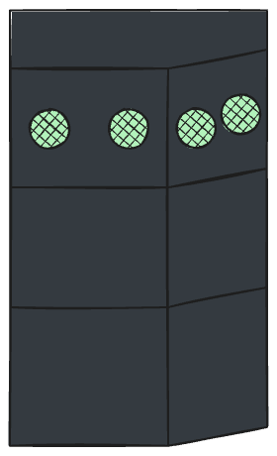
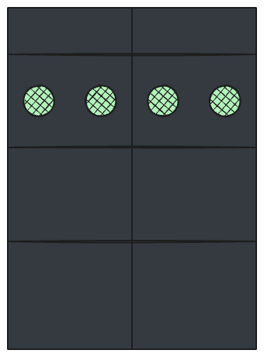
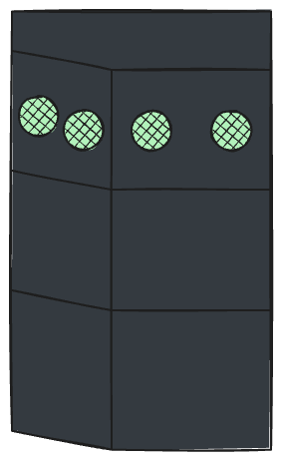


System Architecture
TCP via local WiFi access point
Left Box
Right
Box
CentreBox

Slide 3
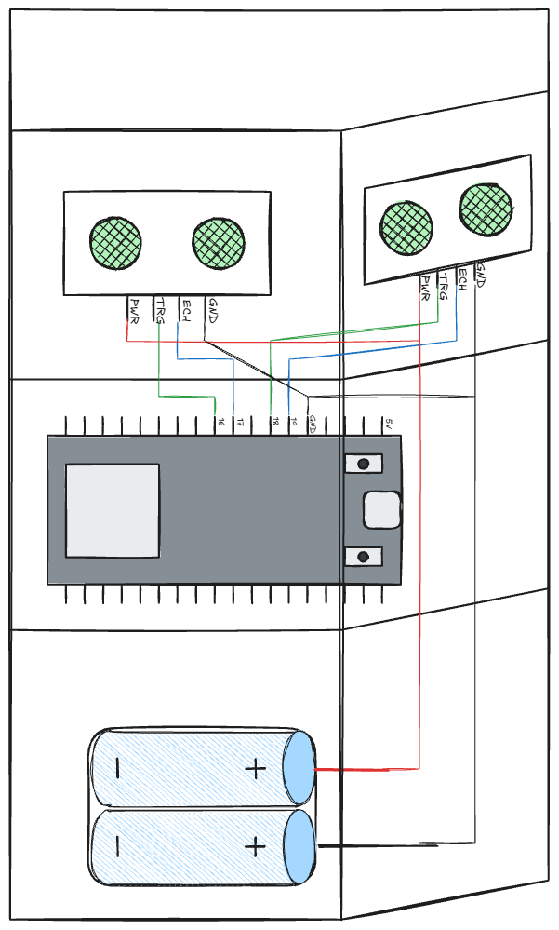
TITLE
Isolated Tiers
Debug one layer at a time
Only faulty tier needs examining
Modular Design
Easy addition of features

Slide 4
TITLE

Slide 5
TITLE

Slide 6
TITLE

